Slide 1

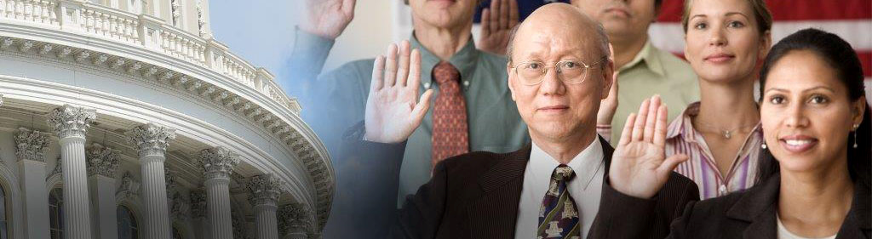
Working with the Community to Protect Immigrants
Nikki Marquez
nmarquez@ilrc.org
Immigrant Legal Resource Center
www.ilrc.org
September 20, 2017

Slide 2
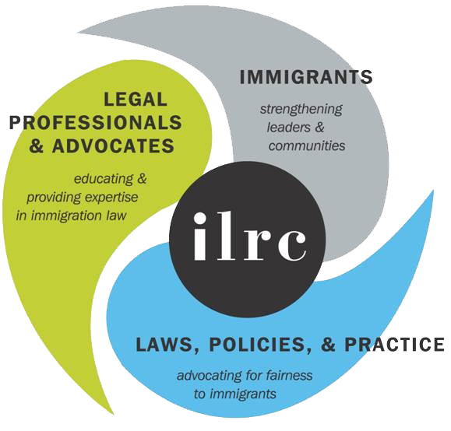
Immigrant Legal Resource Center

Slide 3
Agenda
What is happening now? Immigration under the new administration
What are your rights if ICE comes to your organization?
How can we help immigrants to protect themselves?
Notes:
Today, I will be talking about:
What is happening now?
Executive Order on Enforcement
Tactics are changing…not the law
How can school staff protect immigrant families?
Right to free public education
Know Your Rights if ICE comes to school
Communicate protocols to parents and community
How can we help immigrants to protect themselves?
Avoid panic.
Know Your Rights for Legal Self Help; Red Cards
Family and emergency planning

Slide 4
Remain calm and
stay informed.
Preparation will help reassure your clients and their families, and reduce the overall fear and panic of the community.

Slide 5
What is Happening Now?
Immigration Under the New Administration

Slide 6
Immigration in the U.S.
Immigration
Federal Laws
Agency Policies
Executive Orders
Federal Court Cases
Circuit Court Cases
Regulations
State and Local Laws
Local Policies
Notes:
Immigration is confusing and complicated. And it’s changing so fast. So this is some context to help you understand everything we’re hearing about. But at any given time, we’re just talking about a slice of what is happening and what it looks like today. But that could all change very quickly.
When we talk about immigration, rarely are talking about one thing but rather some combination of all these factors
Congress passes immigration law, however the Executive branch is tasked with enforcing those laws and does so through DHS and its subagencies: Immigration and Customs Enforcement (ICE), Customs and Border Patrol (CBP), and Citizenship and Immigration Services (USCIS)
But there are also a lot of other factors that influence how the law is interpreted and enforced
All that is to say, it’s complicated, confusing, and really hard to know what is actually happening and what all these recent changes mean. As a result, there is a lot of fear and panic in the community.
Currently, immigration law (as passed by Congress) has not changed. However, enforcement of these laws has changed dramatically: leash is off of ICE agents, DACA getting rescinded.

Slide 7
Administration’s Priorities
Asking Congress for money to hire more ICE/border agents, construct new detention centers, build a wall, hire more immigration judges.
ICE can arrest any undocumented person. Officially the highest priorities are people who were convicted or accused of any crime, or who ICE thinks committed any crime – or any other person ICE decides is dangerous.
Partnering with local law enforcement and local agencies to tap into and utilize local resources.

Slide 8

DACA Update
September 5, 2017 Announcement:
  Process pending INITIAL applications accepted as of 9/5/2017
  Reject all new INITIAL applications after 9/5/2017
  Process all pending RENEWAL applications that have been filed
  Accept and process RENEWAL applications until 10/5/2017 if DACA expires between 9/5/2017 and 3/5/2018
  Reject all INITIAL and RENEWAL applications after 10/5/2017

Slide 10
Proposed Federal Laws
None have passed – not law
Good
Bad
Increased funding and personnel across DHS
Limits on legal immigration
Prohibition on sanctuary cities
Path to legalization for some immigrant students
Border wall
Notes:
Border Security for America Act
Authorizes border wall
5,000 Border Patrol Agents and 5,000 CBP officers
Use of the National Guard
Building America’s Trust Act
$15 billion over 4 years
Increased personnel across DHS
Prohibits sanctuary cities
Reforming American Immigration for a Strong Economy Act
Limits legal immigration with emphasis on skills
Limit number of refugees
Prioritizes immediate family members
Concern is given the current state of our federal legislature, we likely won’t see any comprehensive immigration reform for a long time.

Slide 11
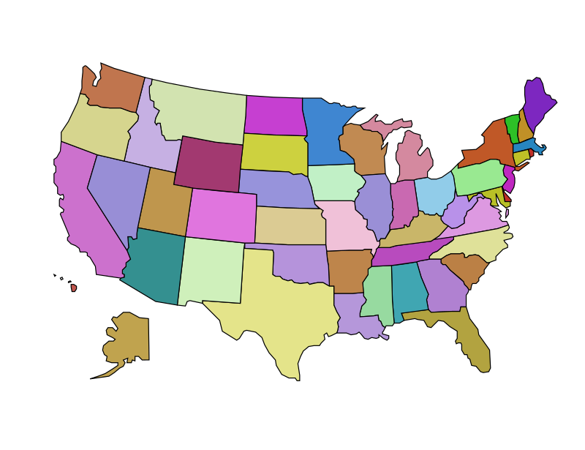
State Laws
Some states are introducing additional state legislation creating benefits and some protections for immigrants like California has done.
Other states are introducing legislation that increases immigration enforcement at the local level like Texas has done.
Notes:
CA SB 54: CA Values Act
Prohibit state and local law enforcement agencies, including school police and security departments, from using resources to investigate, interrogate, detain, detect, or arrest persons for immigration enforcement purposes, as specified.
COLORADO: Not currently in session (on break from May – December) so keep an eye out next year for potential bills that might impact immigrants. But the ILRC can serve as a resource based on our experiences in CA. What’s great about working at the state level is the opportunity to learn from one another.
TX SB 4:
SB 4 will ban sanctuary cities in Texas. The law requires local government and law enforcement to follow all federal immigration laws and detainer requests, putting in place criminal penalties if anyone breaks the new law.
While there are some great efforts taking place in some states, they don’t get to the underlying issue. There are limits on what states can do and as a result the immigrant experience can vary greatly from one state to the next.

Slide 12

Local Efforts
Sanctuary Policies
KYR Presentations
Pro Bono attorneys and volunteers
Allies are coming together
Notes:
Sanctuary Policies
Cities, counties, police departments, sheriffs → focusing local resources on local needs
Community leaders are giving KYR presentations and sharing resources → this includes schools, health centers, and other trusted institutions within the community who may not have played this role before
Volunteers → attorneys and non-attorneys who are volunteering their time and services
Allies are coming together → recognizing that immigrants are interwoven within our communities. This is an issue that impacts us all in some way.

Slide 13
What are your rights if ICE comes to your organization?
Know your rights

Slide 14

What You Can Do
It’s important to be prepared
Preparation will help reassure your clients and their families, and reduce the overall fear and panic of the community
Notes:
Muzzle is off
Example of USCIS officer who went to NY school
Looking to verify enrollment for public benefits, not ICE doing enforcement activities, but prepared.

Slide 15
Concerns about ICE
ICE at your organization
  Fourth Amendment protections against unreasonable searches and seizures
    Don’t have to allow ICE on non-public parts of campus without a judicial warrant or probable cause
  ICE Sensitive Places Memo
    Reaffirmed internal policy against enforcement actions on school campuses, hospitals, places of worship, marches and protests
    www.ice.gov/doclib/ero-outreach/ pdf/10029.2-policy.pdf

Slide 16

Concerns about ICE
ICE asking for records
  Don’t have to share private records
  But must disclose records if ICE has a judicial warrant
  Can’t share what you don’t have
  Federal Educational Rights and Privacy Act (FERPA) and Health Insurance Portability and Accountability Act (HIPAA) are additional protections

Slide 17
Concerns about ICE
Have a protocol in place for if ICE comes to your organization or requests records
  Do not collect information about immigration status if you don’t have to. You can’t share what you don’t have!
  Have a point person for staff to notify immediately if ICE comes onsite or asks for records.
  All students and clients should be treated equitably.
  Take into consideration immigration consequences of bringing law enforcement onsite.

Slide 18

What Organizations and Staff Can Do
Under the current administration there is a renewed emphasis on ICE collaborating with local law enforcement
  Exposure to the criminal and juvenile justice systems may also expose students to ICE
  Review policies to see where and when clients might interact with police

Slide 19
What Organizations and Staff Can Do
Provide resources and know what families can do now
  Share resources with staff
  Don’t advertise “undocumented immigration” forums – people may be scared and won’t show up

Slide 20
What Organizations and Staff Can Do
REMEMBER:
There is a very small chance that ICE will come to your school or health center.
But this information will help your be prepared, remain calm, and reassure your clients, students, and their families.

Slide 21
How can we help immigrants to protect themselves?
What Immigrant Families
Should Do Now

Slide 22
What Immigrant Families Should Do Now
Understand your rights and practice asserting them!
Put a child care and family preparedness plan in place
Figure out which documents you should and should not carry
Talk to an immigration services provider about immigration options
People should continue to avoid negative interaction with law enforcement. Something like a DUI or conviction related to drugs can have irreversible negative immigration consequences.

Slide 23

Legal Self-defense: Know Your Rights!
Anywhere:
  ICE must prove the person is not a USC.
  You ALWAYS have the right to remain silent.
In the home:
  ICE must have a warrant signed by a judge to enter anyone’s house.
  They almost never have this.

Slide 24
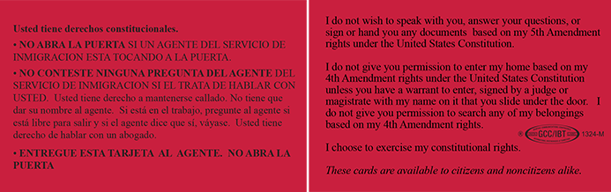
Know Your Rights
Order Red Cards in bulk at www.ilrc.org/red_cards

Slide 25

Eligible LPRs - Naturalize
There are many benefits including:
Protection from deportation
Ability to petition more family members
Ability to petition some family members faster
Ability to VOTE!
Notes:
If you have a green card, find out if you can become a U.S. citizen

Slide 26

Undocumented – Screen for Relief
There are many options including some for:
Those who have U.S. citizen or green card holder family members
Those who have been abused by a U.S. citizen or green card holder family member
Victims of certain crimes or forced work
Those who are afraid to return to their home country
And more!

Slide 27
Address old convictions
Trump is prioritizing people with convictions – so it is important to consult with a post-conviction specialist to determine if there is anyway to clean up criminal records.
Obtain a copy of the criminal record from the local courthouse or from the state DOJ

Slide 28
In summary…
Remain silent
Don’t open the door
Speak with an attorney
Don’t sign anything
Don't show false documents
Don't get nervous, don't run
Make a family plan
It's your decision

Slide 29
Additional Resources

Slide 30
Resources
To refer someone to a nonprofit immigration law agency, see directory at www.immigrationadvocates.org/nonprofit/legaldirectory/search?state=CA
To download free printed community resources from the ILRC, go to www.ilrc.org/community-resources
New Americans Campaign (naturalization) http://newamericanscampaign.org/

Slide 31
Resources
ILRC’s DACA Resources: https://www.ilrc.org/daca
KYR and What Immigrant Families Should Do Now https://www.ilrc.org/know-your-rights-and-what-immigrant-families-should-do-now
Family Preparedness Plan: https://www.ilrc.org/family-preparedness-plan
ACLU: KYR When Encountering Law Enforcement https://www.aclu.org/files/kyr/kyr_english.pdf

Slide 32
Resources
Post-Election Q&A for Advocates and Attorneys Serving Immigrant Survivors of Gender-Based Violence: https://www.ilrc.org/post-election-qa-advocates-and-attorneys-serving-immigrant-survivors-gender-based-violence
UACs and EOs: https://www.ilrc.org/unaccompanied-minors-new-executive-orders
Rights of LPRs: https://www.ilrc.org/rights-lawful-permanent-residents

Slide 33
Resources
Post-Election Resource for Schools https://www.ilrc.org/post-election-resource-schools
California Primary Care Association www.cpca.org/cpca/assets/File/Policy-and-Advocacy/Active-Policy-Issues/MSFW/2012-10-17-ICE-Raid-Summary-Updated.pdf
CCSA’s Protecting Undocumented and Vulnerable Students: http://www.ccsa.org/2017/06/protecting-undocumented-and-vulnerable-students.html

